Slide 1

Application of MRF in Video Object Segmentation
GitHub repo: https://github.com/16261909/CS5340-Project/
Team 10: Zhang Rongqi, Li Xingchen, Wang Ganyi, Yang Boran (Presenter)

Slide 2

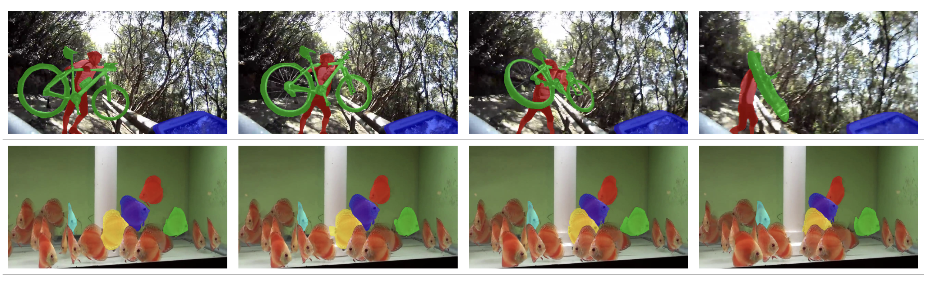

What is Video Object Segmentation?
Figure 1. Ref: [1]
Separate foreground object(s) from the background in continuous frames of a video
It requires not only the recognition of objects in a single frame just like the typical image segmentation task, but also the continuous tracking of these object(s)

Slide 3
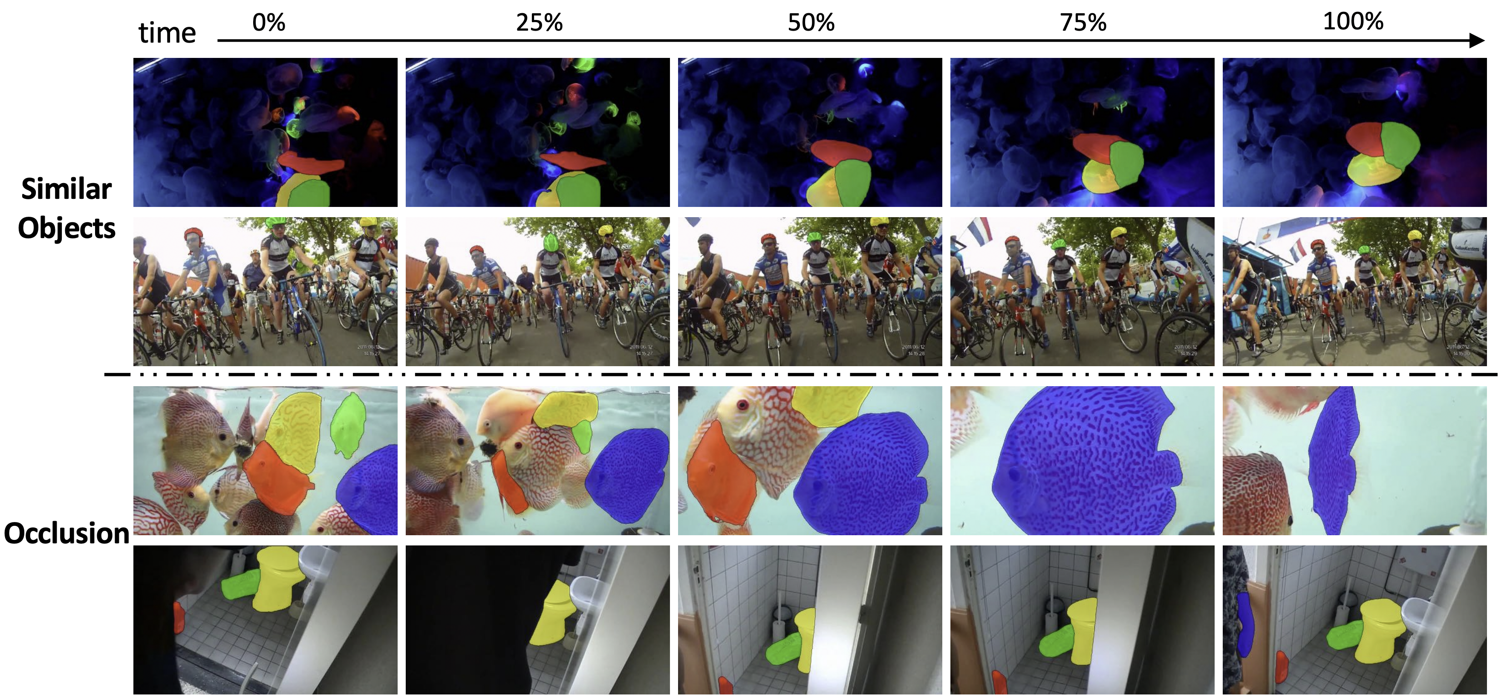
Challenges
In real scenarios, the video object segmentation task is affected by various factors, such as
Lighting conditions
Occlusions
Variety of object appearances
Diverse backgrounds in video streams
Presence of multiple similar objects
Can significantly increase the complexity of the task!
Figure 2. Ref: [2]

Slide 4
Related Work
Handcrafted Feature-based Methods
Classical Machine Learning Methods
Deep Neural Network Models
Rule-based algorithms that relied on colour and texture features to distinguish objects from the background
Histogram statistics
Optical flow
Clustering methods
Graph models
Support vector machines
Random decision forests
Markov Random fields
Multi-layer perceptron
Recurrent neural networks (RNNs)
LSTM
Mask R-CNN
Feature extractor + optical flow

Slide 5
Method Overview
Innovation points are highlighted *
Key points:
Combining temporal (optical flow) and spatial (CNN) information for mask generation
Pretrained CNN with data augmentation
Using neural networks to obtain the Optical Flow
Introducing dynamical coefficients for energy term
We use a weak CNN intentionally (Highlight MRF)
Using sigma detection to perform noisy optical flow filtering

Slide 6
Method Overview
Innovation points are highlighted *
Computational Optimization:
Using Loss from CNN to approximate spatial energy function
Using the L2 norm of the difference between x and y to approximate solution to the energy function
Using image compression and nearest-neighbor interpolation
Parallelization of energy function computation
Pre-compute the pixel locations

Slide 7
Energy Function
$E(x)$= unary energy + temporal energy + spatial energy

Slide 8

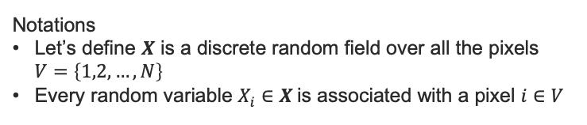
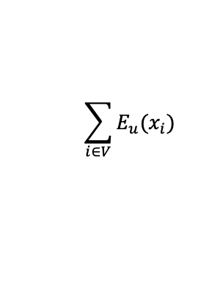
Energy Function
Notations
Let’s define $X$ is a discrete random field over all the pixels $V=\left\{1,2,…,N\right\}$
Every random variable $X_{i}∈X$is associated with a pixel $i∈V$
$E(x)$= unary energy + temporal energy + spatial energy
$$\sum_{i∈V}{E_{u}(x_{i})}$$
: defined as negative log likelihood of the labelling for each pixel, measure the overall compatibility of the label assignment, obtained by OSVOS
One-Shot Video Object Segmentation (OSVOS): a deep-learning based approach for video object segmentation.
Original video
Ground Truth mask
Predicted mask with Unary only
Figure 3

Slide 9
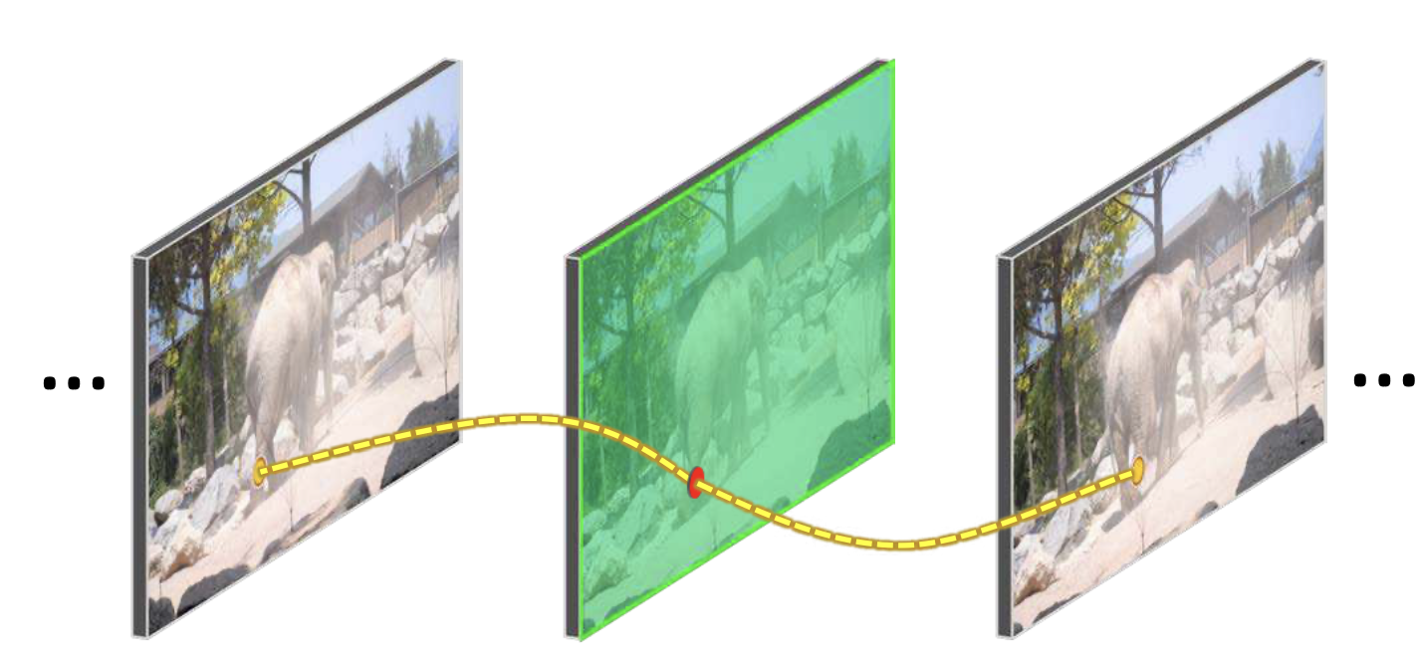
Optical Flow
$E(x)$= unary energy + temporal energy + spatial energy
It measure the pixel correspondence between images
Using this information to temporally constrain the generated results
Figure 4: The Spatio-temporal dependency [3]

Slide 10

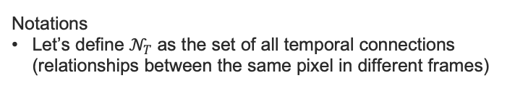
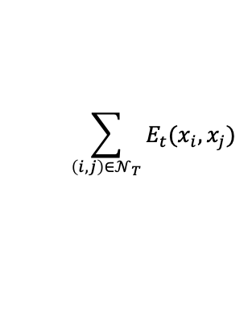
Energy Function
Notations
Let’s define $𝒩_{T}$ as the set of all temporal connections (relationships between the same pixel in different frames)
$E(x)$= unary energy + temporal energy + spatial energy
$$\sum_{\left(i,j\right)∈𝒩_{T}}{E_{t}(x_{i}, x_{j})}$$
: with the help of optical flow, if there is a high confidence in the correspondence between pixels in two continuous frames. It will encourage a temporally consistent labelling.
Original video
Ground Truth mask
Predicted mask with Temporal only
Figure 5

Slide 11


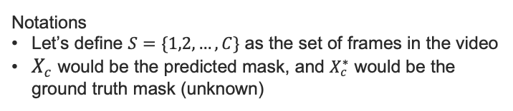
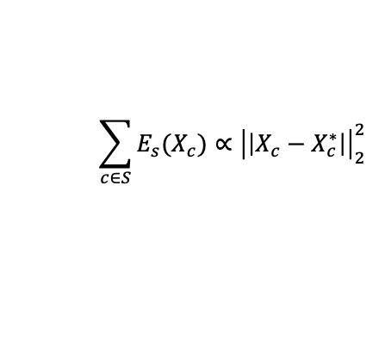
Energy Function
Notations
Let’s define $S=\{1,2,…, C\}$ as the set of frames in the video
$X_{c}$ would be the predicted mask, and $X_{c}^{∗}$ would be the ground truth mask (unknown)
$E(x)$= unary energy + temporal energy + spatial energy
$$\sum_{c∈S}{E_{s}(X_{c})}∝{\left|\left|X_{c}−X_{c}^{∗}\right|\right|}_{2}^{2}$$
Minimize the loss function for CNN
Minimize the spatial term
The loss from CNN only contains spatial information
Use CNN’s loss function to approximate spatial term
Original video
Ground Truth mask
Unary + Temporal
Original video
Ground Truth mask
Unary + Temporal + Spatial
Figure 6

Slide 12


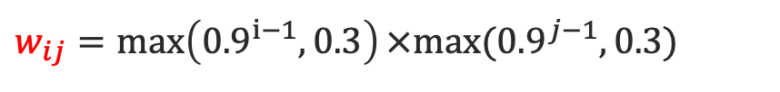
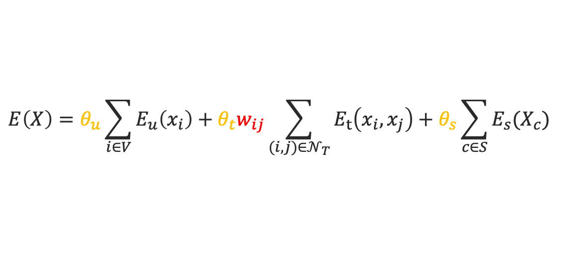
Final Energy Function
Notations
Let’s define index of frame$i,j∈$ {1, 2, …, C}
$$E\left(X\right)=θ_{u}\sum_{i∈V}{E_{u}\left(x_{i}\right)}+θ_{t}w_{ij}\sum_{(i,j)∈𝒩_{T}}{E_{t}\left(x_{i},x_{j}\right)}+θ_{s}\sum_{c∈S}{E_{s}(X_{c})}$$
$$w_{ij}=\max\left({0.9}^{i−1}, 0.3\right)×max⁡({0.9}^{j−1}, 0.3)$$
Unary
Unary + Temporal
Unary + Temporal + Spatial
Figure 7

Slide 13
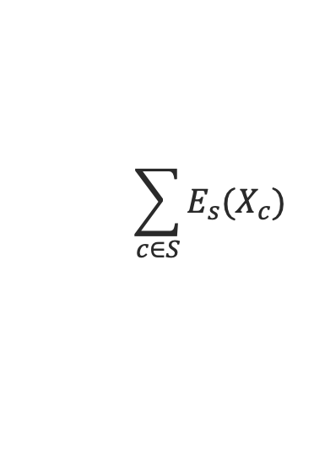
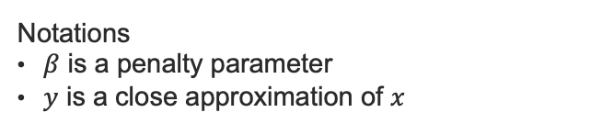
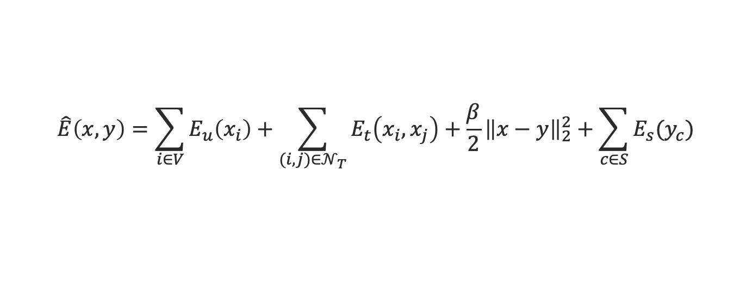
Inference
Notations
$β$ is a penalty parameter
$y$ is a close approximation of $x$
The higher-order energy function makes the inference problem intractable.
$$\sum_{c∈S}{E_{s}(X_{c})}$$
Approximation:
$$\hat{E}\left(x,y\right)=\sum_{i∈V}{E_{u}\left(x_{i}\right)}+\sum_{(i,j)∈𝒩_{T}}{E_{t}\left(x_{i},x_{j}\right)}+\frac{β}{2}{\left\|x−y\right\|}_{2}^{2}+\sum_{c∈S}{E_{s}(y_{c})}$$
Optimized by MRF
Optimized by the loss from CNN

Slide 14
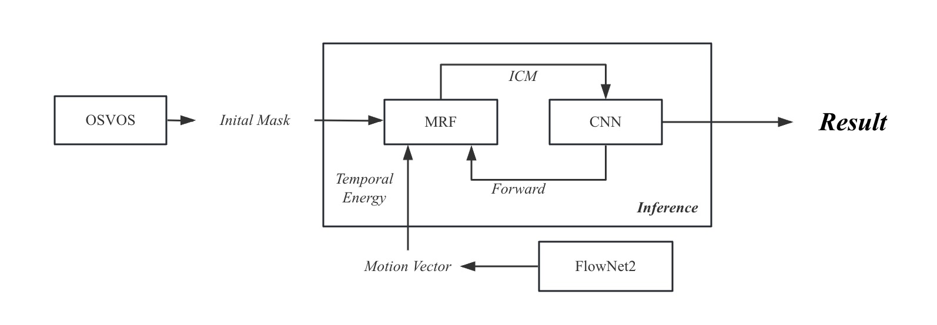
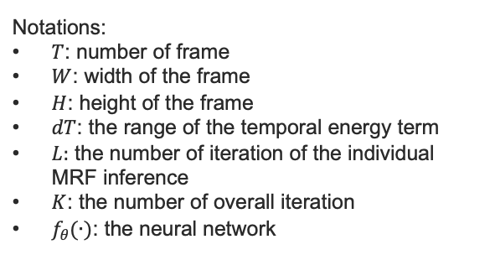
Inference Time Complexity
$$O(\left(f_{θ}\left(T×W×H\right)+T×W×H×dT×L\right)×K)$$
CNN
Individual MRF inference
Time complexity is very high!
Notations:
$T$: number of frame
$W$: width of the frame
$H$: height of the frame
$dT$: the range of the temporal energy term
$L:$ the number of iteration of the individual MRF inference
$K$: the number of overall iteration
$f_{θ}(∙)$: the neural network
Figure 8. Computational flow (alternately processing MRFs and CNNs)

Slide 15
Inference
Traditional Iterated Conditional Modes (ICM):
Sequentially update each pixel while fixing others (leading to dependencies)
Alternative implementation :
Calculate the energy for all pixels using the old data, and update all pixels in parallel
Comparison on DAVIS 2017 Challenge Dataset[4]
ICM: 10 minutes per iteration
Alternative implementation: 2 minutes per iteration
Makes the inference 5 times faster !

Slide 16
Experimental results
Our method: post-processing that reduces the noise from OSVOS
Original video
Ground Truth
OSVOS (Unary)
Temporal
Unary + Temporal
Unary + Temporal + Spatial
Figure 9

Slide 17


Thanks!

Slide 18
References
[1] https://youtube-vos.org/
[2] https://github.com/yoxu515/aot-benchmark
[3] Bao, L., Wu, B., & Liu, W. (2018). CNN in MRF: Video object segmentation via inference in a CNN-based higher-order spatio-temporal MRF. In Proceedings of the IEEE conference on computer vision and pattern recognition (pp. 5977-5986).
[4] Benchmark Video Object Segmentation on DAVIS, 2017. Available at http://davischallenge.org/soa_compare.html

